Slide 2
protein

Slide 3
Protein, highly complex substance that is present in all living organisms. Proteins are of great nutritional value and are directly involved in the chemical processes essential for life. The importance of proteins was recognized by chemists in the early 19th century, including Swedish chemist Jöns Jacob Berzelius, who in 1838 coined the term protein, a word derived from the Greek proteios, meaning “holding first place.” Proteins are species-specific; that is, the proteins of one species differ from those of another species. They are also organ-specific; for instance, within a single organism, muscal proteins differ from those of the brain and liver.

Slide 4
A protein molecule is very large compared with molecules of sugar or salt and consists of many amino acids joined together to form long chains, much as beads are arranged on a string. There are about 20 different amino acids that occur naturally in proteins. Proteins of similar function have similar amino acid composition and sequence. Although it is not yet possible to explain all of the functions of a protein from its amino acid sequence, established correlations between structure and function can be attributed to the properties of the amino acids that compose proteins.

Slide 5
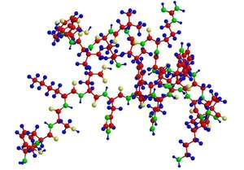
Peptide (a small protein molecule)

Slide 6
General structure and properties of proteins
the common property of all proteins is that they consist of long chains of α-amino (alpha amino) acids. The general structure of α-amino acids is shown in . The α-amino acids are so called because the α-carbon atom in the molecule carries an amino group (―NH₂); the α-carbon atom also carries a carboxyl group (―COOH).

Slide 8
